Slide 1
Repeated Games
Game 7

Slide 2
Opponent Personalities
Tit-For-Tat
Tit-For-Two-Tat
Grim Trigger Strategy
Random
Equilibrium

Slide 3
Opponent Personalities
Tit-For-Tat
  Cooperate→Cooperate Defect→Defect
Tit-For-Two-Tat
  Cooperate→Cooperate Defect twice→Defect
Grim Trigger Strategy
  Cooperate→Cooperate Defect→Defect forever
Random
  Flip a coin: Heads→Cooperate, Tails→Defect
Equilibrium
  Defect, defect, defect, …

Slide 4
Highest & Lowest Payoffs
maximum minimum
Tit-for-Tat 20 +0.4 10 +0.8
Tit-for-Two-Tat 25 +0.2 10 +1.6
Grim Trigger 20 +0.4 10 +0.8
Random 20 (avg) 10 (avg)
Equilibrium 10 0
95 +1.0 40 +3.2

Slide 5
Highest Payoffs & Tit-For-Tat
maximum Tit-For-Tat
Tit-for-Tat 20 +0.4 20 +0.4
Tit-for-Two-Tat 25 +0.2 20 +0.4
Grim Trigger 20 +0.4 20 +0.4
Random 20 (avg) 15 (avg)
Equilibrium 10 10 +0.4
95 +1.0 85 +0.8

Slide 6
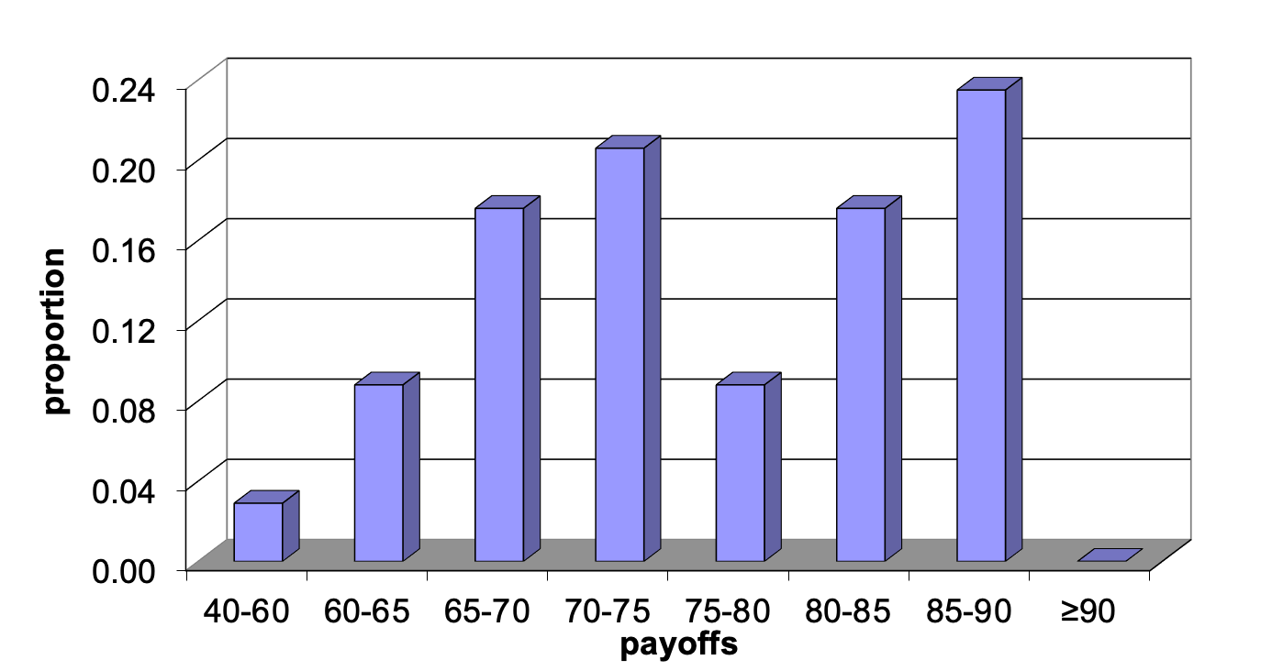
Class Results
Random
Tit-for-tat

Slide 7
Grading on a Curve
Score between 0 and 100
How close are you to one of these two benchmarks?
Random: 61 (low) → 0
Tit-for-tat: 86 (high) → 100
(Note: always defect earns 64 → 12)

Slide 8
Highest Scores
Andrew B. 110
Tianqi 110

Slide 9
And…
Lauren 9
Spencer 2

Slide 10
And…
Alessia –11

Slide 11
The Flip Side
How my evil opponents did against the class
Tit-for-Tat
Grim Trigger Strategy
Equilibrium (Defect)
Tit-for-Two-Tat
Random

