Slide 1
Your Value to a Game
Game 3

Slide 2
Your Value to a Game
You
Director of a commercial-free music video channel
Streaming services pay to carry you
You make a take-it-or-leave-it offer
Streaming Services
Each channel has $100K in value
Streaming services have varying capacities
Select the lowest k offers, k = 50, 30, 20

Slide 3
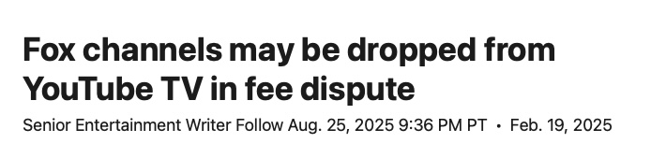
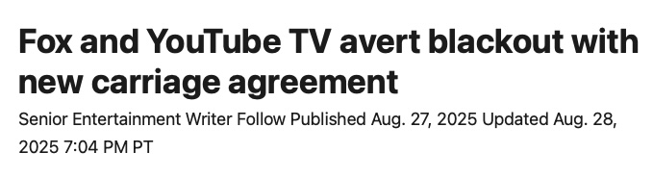
Channel Negotiations

Slide 4
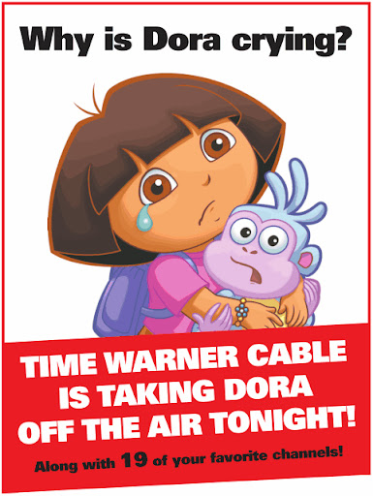
Channel Negotiations
Full page ad in
The New York Times

Slide 5
Unlimited Capacity
(k=50)
What is your value to the game?
How much should you be paid?

Slide 6
Unlimited Capacity
(k=50)
What is your value to the game?
How much should you be paid?
Most requested $100,000
But some love cable companies; several asked for <$50,000

Slide 7
Slightly Limited Capacity
(k=30)
What is your value to the game?
How much should you be paid?

Slide 8
Limited Capacity
(k=20)
What is your value to the game?
How much should you be paid?

Slide 9
Class Results
 | k = 50
Average offer: | 89
Accept offers below: | 100
Average accepted offer: | 84
My profit per channel: | 16
My profit: | x 32 = 512
 |  | k = 30
 |  | 58
 |  | 90
 |  | 53
 |  | 47
 |  | x 30 = 1410 (+175%)
 |  |  | k = 20
 |  |  | 29
 |  |  | 30
 |  |  | 10
 |  |  | 90
 |  |  | x 20 = 1800 (+252%)

Slide 10
Intuition
By reducing capacity
  I reduce the value of the game
  But I gain bargaining power
  I get higher profit per channel
  I get higher profits overall

Slide 11
Class Results
Best Score
  Maximum possible: 100 + 90 + 30 = 220
  Elijah 100 + 70 + 20 = 190
  Ava 99.995 + 90 + 50 = 190

